Slide 1
Dimension Reduction for Big Data
25th June 2018
Devin Nanayakkara

Slide 2
Overview
Dimension Reduction for Big Data
25th June 2018
Introduction
Motivation
Goal
Implementation
Results
Conclusion

Slide 3






Applications
Dimension Reduction for Big Data
25th June 2018
Analytics
Business Intelligence
Infrastructure
Other Technologies

Slide 4
Curse of Dimensionality
Dimension Reduction for Big Data
25th June 2018
Data isolation
Notes:
As dimensionality increases, the volume of the space also increases.
More and more samples are required to perform machine learning or statistical analysis.

Slide 5
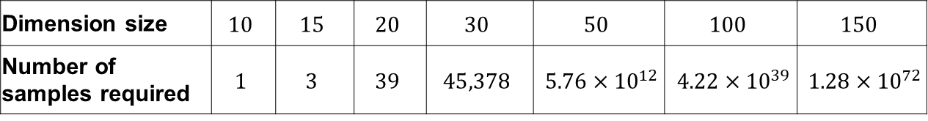
Curse of Dimensionality
Dimension Reduction for Big Data
25th June 2018
Data isolation
Number of training samples required for a K-Nearest Neighbour search algorithm
Dimension size | $$10$$ | $$15$$ | $$20$$ | $$30$$ | $$50$$ | $$100$$ | $$150$$
Number of samples required | $$1$$ | $$3$$ | $$39$$ | $$45,378$$ | $5.76×{10}^{12}$ | $4.22×{10}^{39}$ | $1.28×{10}^{72}$

Slide 6
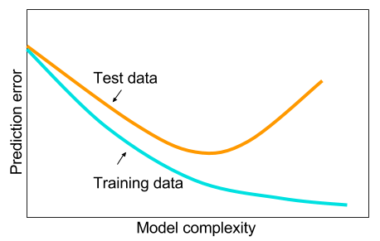
Curse of Dimensionality
Dimension Reduction for Big Data
25th June 2018
Data isolation
Overfitting
Notes:
The complexity of the data increases with the dimensionality.
In a neural networks application, the hidden layers will be very complex.
This leads to…..

Slide 7
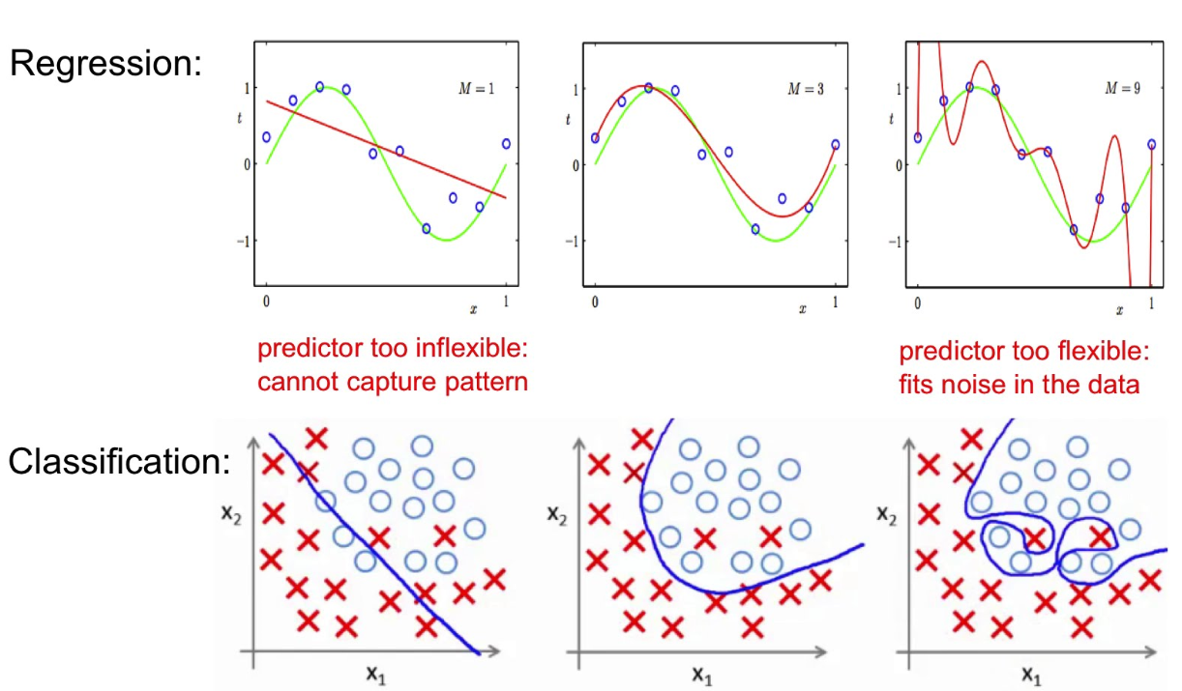
Curse of Dimensionality
Dimension Reduction for Big Data
25th June 2018
Data isolation
Overfitting
False Structure

Slide 8
Curse of Dimensionality
Dimension Reduction for Big Data
25th June 2018
Data isolation
Overfitting
False Structure
Computation difficulty
Time
Complexity
Notes:
A simpler, but sometimes very effective,
way of dealing with high-dimensional data is to reduce the number of dimensions

Slide 9
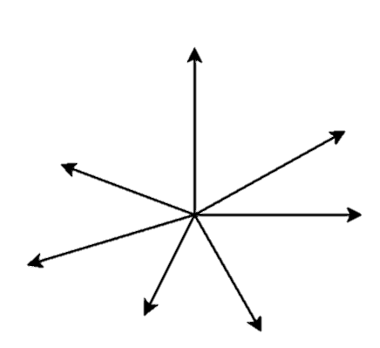
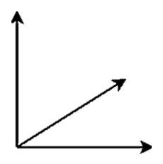



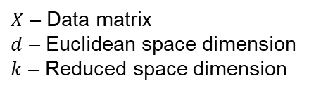


Random Projection (1)
Dimension Reduction for Big Data
25th June 2018
$$Φ$$
$$d>k$$
$X$ in $ℝ^{d}$
$Φ(X)$ in $ℝ^{k}$
Assist applications whose data is represented geometrically in high dimensional vector spaces
$X$ – Data matrix
$d$ – Euclidean space dimension
$k$ – Reduced space dimension

Slide 10
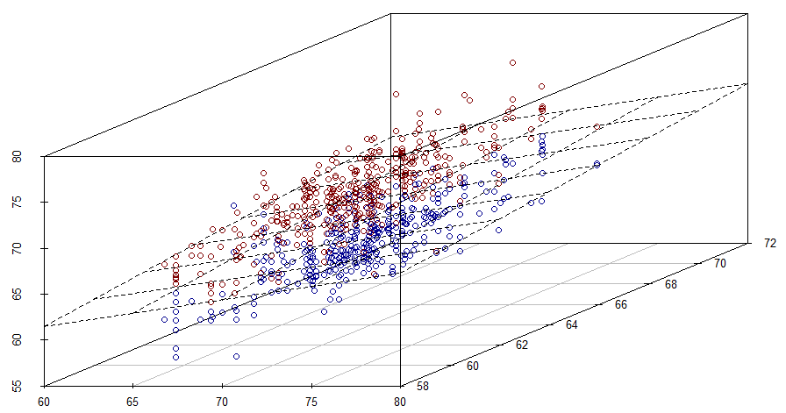
Random Projection (2)
Dimension Reduction for Big Data
25th June 2018

Slide 11
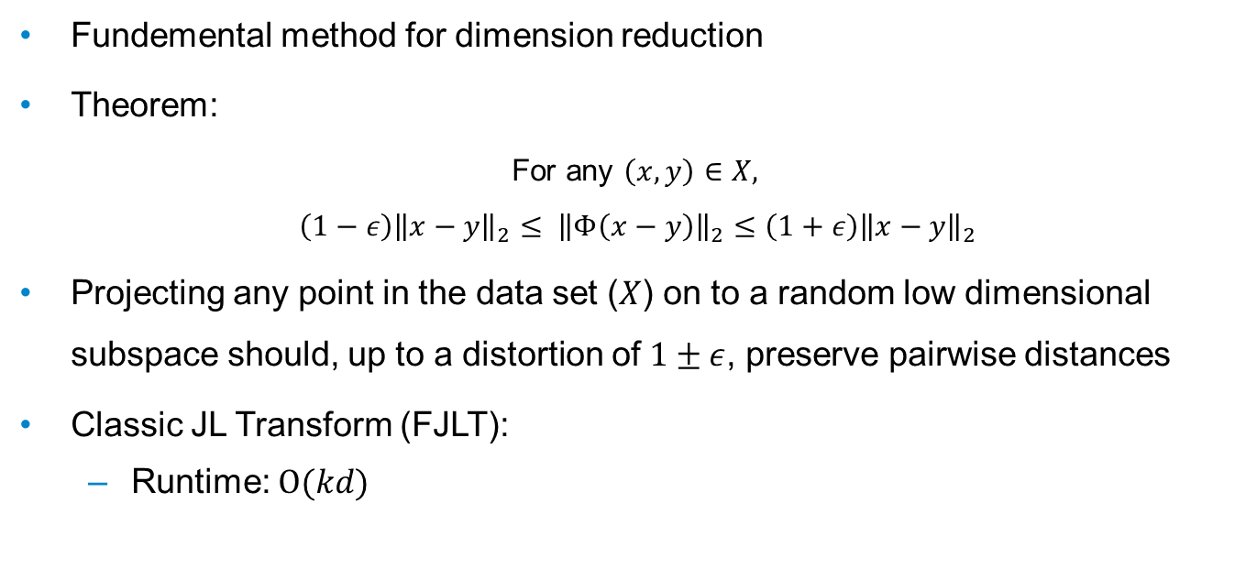
Johnson-Lindenstrauss Transform
Dimension Reduction for Big Data
25th June 2018
Fundemental method for dimension reduction
Theorem:
For any $\left(x,y\right)∈X,$
$$\left(1−ε\right){\left\|x−y\right\|}_{2}≤ {\left\|Φ\left(x−y\right)\right\|}_{2}≤\left(1+ε\right){\left\|x−y\right\|}_{2}$$
Projecting any point in the data set ($X$) on to a random low dimensional subspace should, up to a distortion of $1±ε$, preserve pairwise distances
Classic JL Transform (FJLT):
Runtime: $O(kd)$
k: reduced dimension; d: original dimension; n: sample size

Slide 12
Goal
Dimension Reduction for Big Data
25th June 2018
Implement structured random matrices to speed up the JL transform
Fast JL Transforms (FJLT)
Notes:
yielding low-complexity solutions to dimension reduction
implement efficient random projectors for dimension reduction

Slide 13
Design Methods
Dimension Reduction for Big Data
25th June 2018
FJLT projection method 1
Sparse matrices
FJLT projection method 2
Methods from coding theory

Slide 14

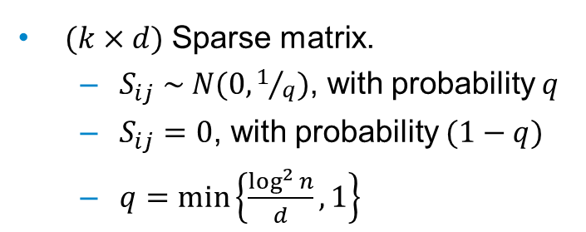
FJLT Method 1
Dimension Reduction for Big Data
25th June 2018
$$Φ=S . H . D$$
$(k×d)$ Sparse matrix.
$S_{ij} \sim N(0,1/q)$, with probability $q$
$S_{ij}=0$, with probability $(1−q)$
$q=\min\left\{\frac{\log^{2}{n}}{d},1\right\}$
k: reduced dimension; d: original dimension; n: sample size
Notes:
Dimension reduction matrix
Sparsifies the input vector
But if input vector is too sparse (i.e. only one non-zero element)

Slide 15
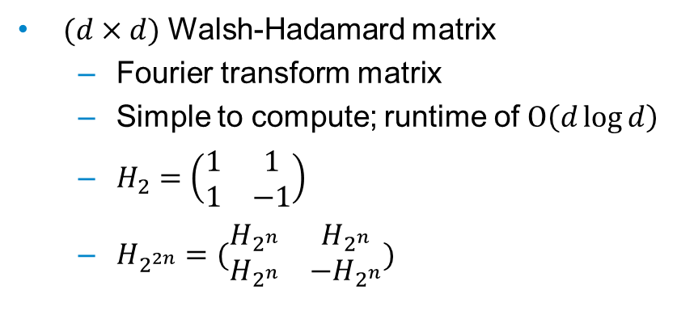
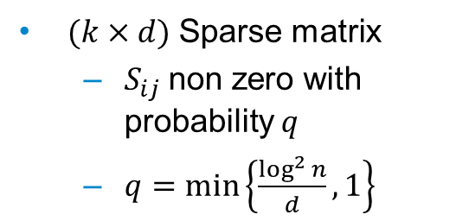
FJLT Method 1
Dimension Reduction for Big Data
25th June 2018
$$Φ=S . H . D$$
$(k×d)$ Sparse matrix
$S_{ij}$non zero with probability $q$
$q=\min\left\{\frac{\log^{2}{n}}{d},1\right\}$
$(d×d)$ Walsh-Hadamard matrix
Fourier transform matrix
Simple to compute; runtime of $Ο\left(d\log{d}\right)$
$H_{2}=\left(\begin{matrix}1 & 1 \\ 1 & −1\end{matrix}\right)$
$H_{2^{2n}}=(\begin{matrix}H_{2^{n}} & H_{2^{n}} \\ H_{2^{n}} & −H_{2^{n}}\end{matrix})$
k: reduced dimension; d: original dimension; n: sample size
Notes:
Densifies the input vector i.e any sparse vector

Slide 16
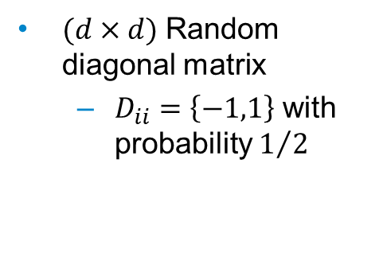
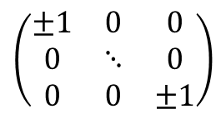
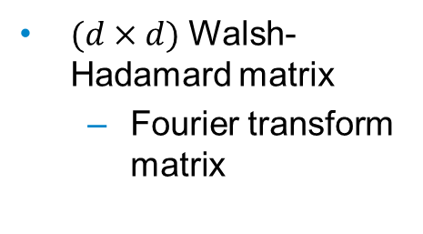
FJLT Method 1
Dimension Reduction for Big Data
25th June 2018
$$Φ=S . H . D$$
$(k×d)$ Sparse matrix
$S_{ij}$non zero with probability $q$
$q=\min\left\{\frac{\log^{2}{n}}{d},1\right\}$
$(d×d)$ Walsh-Hadamard matrix
Fourier transform matrix
$(d×d)$ Random diagonal matrix
$D_{ii}=\left\{−1,1\right\}$ with probability $1/2$
$$\left(\begin{matrix}±1 & 0 & 0 \\ 0 & ⋱ & 0 \\ 0 & 0 & ±1\end{matrix}\right)$$
k: reduced dimension; d: original dimension; n: sample size
Notes:
To make sure that dense vectors does not become sparse, a random matrix is introduced.

Slide 17
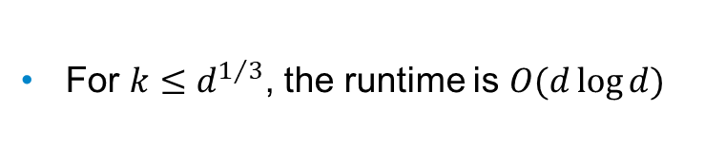
FJLT Method 1
Dimension Reduction for Big Data
25th June 2018
$$Φ=S . H . D$$
$(k×d)$ Sparse matrix
$S_{ij}$non zero with probability $q$
$q=\min\left\{\frac{\log^{2}{n}}{d},1\right\}$
$(d×d)$ Walsh-Hadamard matrix
Fourier transform matrix
$(d×d)$ Random diagonal matrix
$D_{ii}=\left\{−1,1\right\}$ with probability $1/2$
For $k≤d^{1/3}$, the runtime is $O(d\log{d})$
k: reduced dimension; d: original dimension; n: sample size
Notes:
To make sure that dense vectors does not become sparse, a random matrix is introduced.

Slide 18
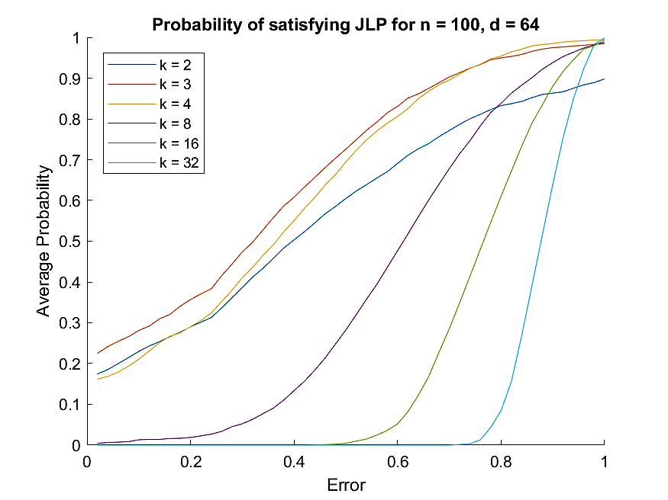
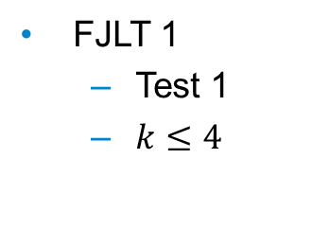
Results
Dimension Reduction for Big Data
25th June 2018
FJLT 1
Test 1
$k≤4$
k: reduced dimension; d: original dimension; n: sample size

Slide 19
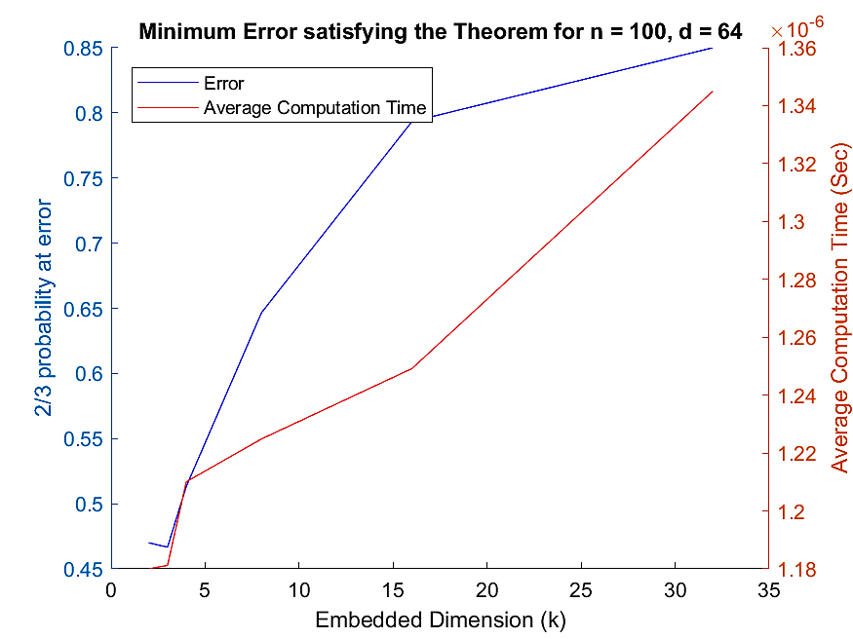
Results
Dimension Reduction for Big Data
25th June 2018
FJLT 1
Test 1
$k≤4$
k: reduced dimension; d: original dimension; n: sample size

Slide 20
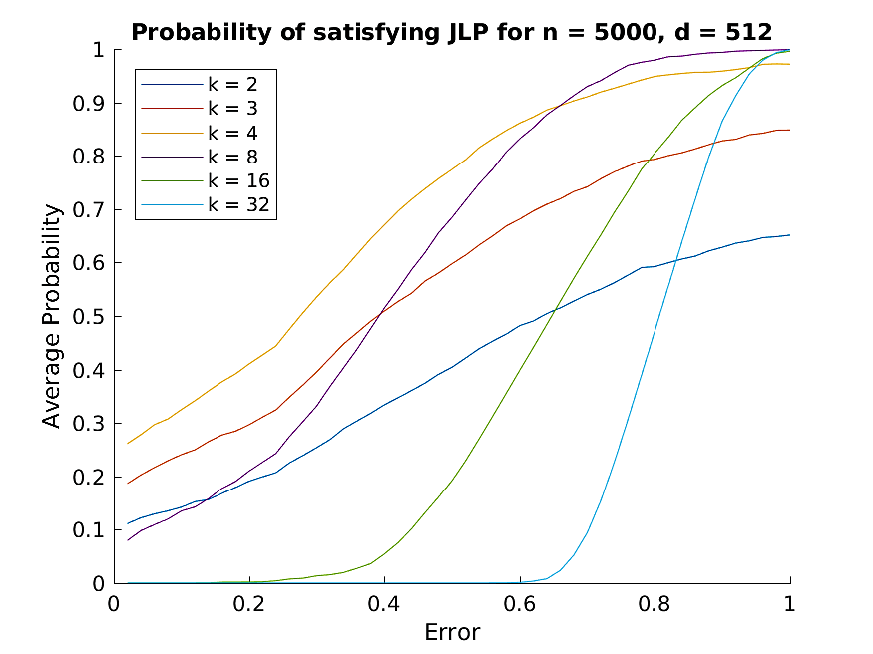
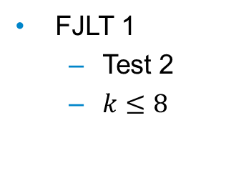
Results
Dimension Reduction for Big Data
25th June 2018
FJLT 1
Test 2
$k≤8$
k: reduced dimension; d: original dimension; n: sample size

Slide 21
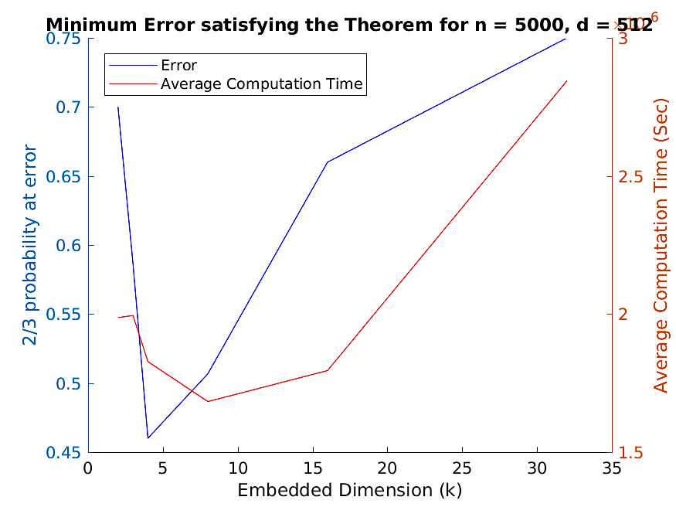
Results
Dimension Reduction for Big Data
25th June 2018
FJLT 1
Test 2
$k≤8$
k: reduced dimension; d: original dimension; n: sample size

Slide 22

Design Methods
Dimension Reduction for Big Data
25th June 2018
FJLT projection method 1
Sparse matrices
Computation time: $O(d\log{d})$
Reduced dimension: $k≤d^{1/3}$
FJLT projection method 2
Methods from coding theory
k: reduced dimension; d: original dimension; n: sample size
Notes:
yielding low-complexity solutions to dimension reduction
implement efficient random projectors for dimension reduction

Slide 23

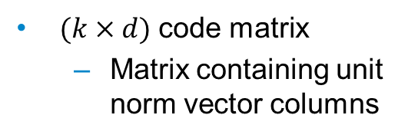


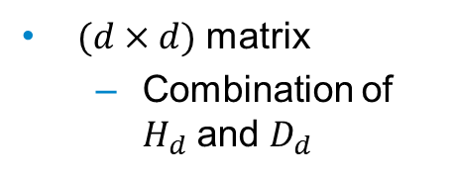

FJLT Method 2
Dimension Reduction for Big Data
25th June 2018
$$Α=B . D . Φ_{d}^{r}$$
$(k×d)$ code matrix
Matrix containing unit norm vector columns
$(d×d)$ Random diagonal matrix
$D_{ii}=\left\{−1,1\right\}$ with probability $1/2$
$(d×d)$ matrix
Combination of $H_{d}$ and $D_{d}$
For $k<d^{1/2}$, the runtime is $O(d\log{k})$
k: reduced dimension; d: original dimension; n: sample size; H: Hadamard matrix

Slide 24
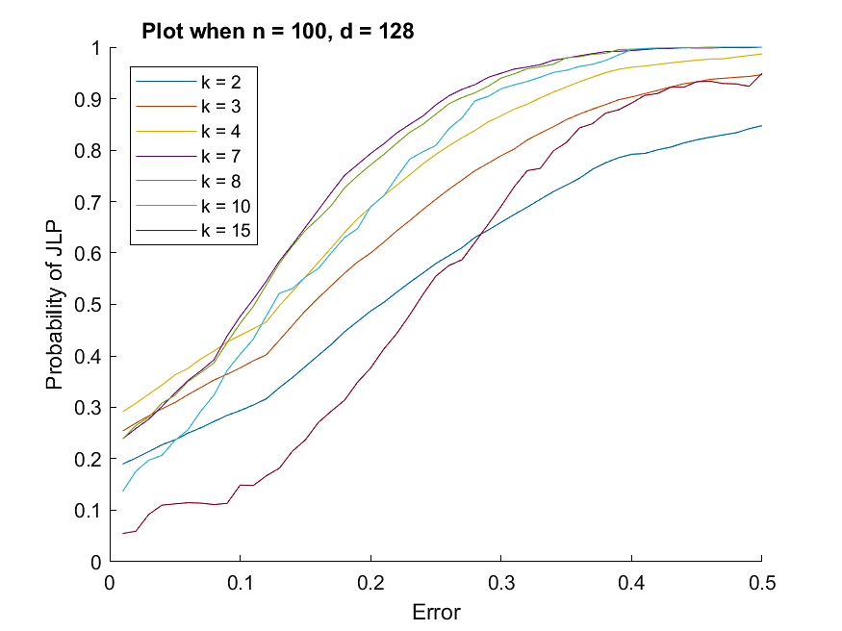
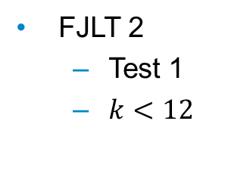
Results
Dimension Reduction for Big Data
25th June 2018
FJLT 2
Test 1
$k<12$
k: reduced dimension; d: original dimension; n: sample size

Slide 25
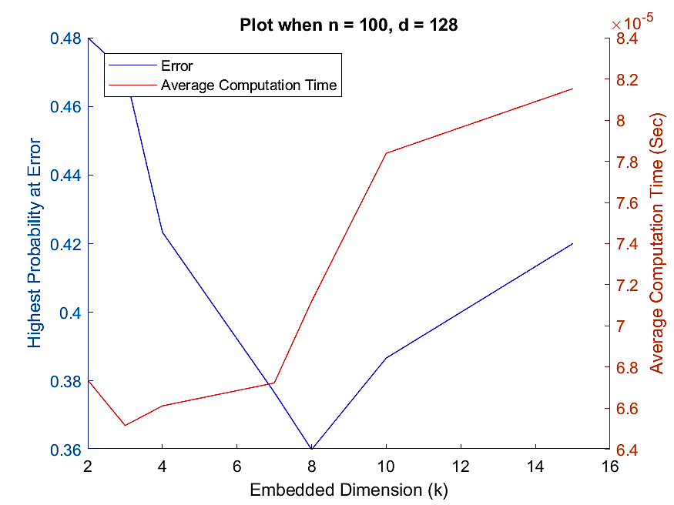
Results
Dimension Reduction for Big Data
25th June 2018
FJLT 2
Test 1
$k<12$
k: reduced dimension; d: original dimension; n: sample size

Slide 26
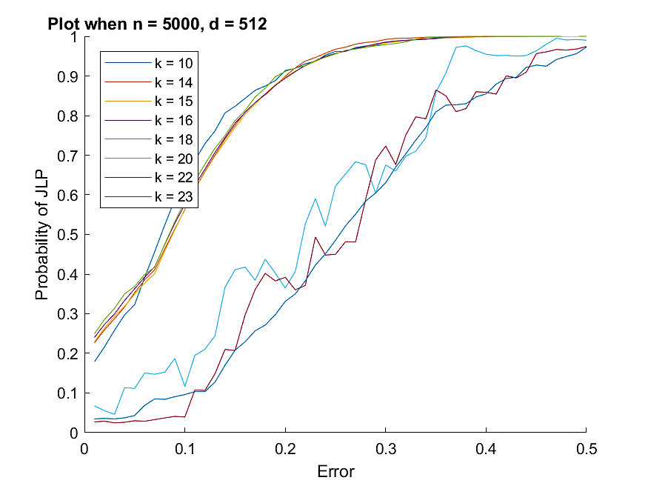

Results
Dimension Reduction for Big Data
25th June 2018
FJLT 2
Test 2
$k<23$
k: reduced dimension; d: original dimension; n: sample size

Slide 27
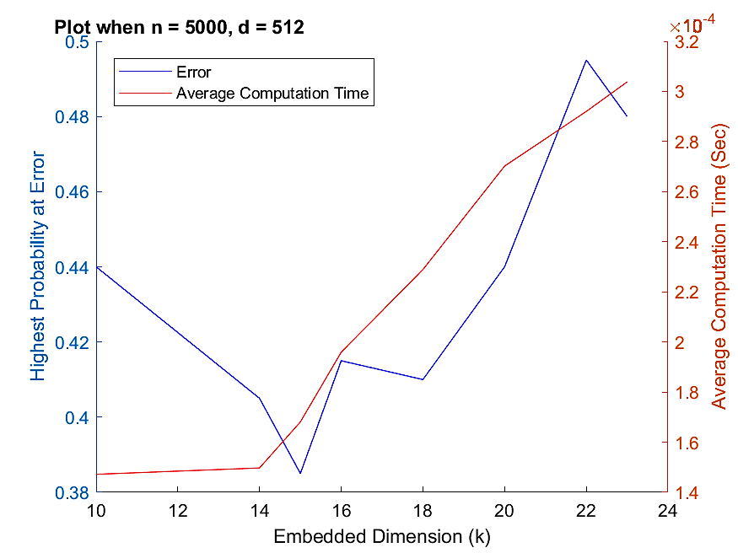
Results
Dimension Reduction for Big Data
25th June 2018
FJLT 2
Test 2
$k<23$
k: reduced dimension; d: original dimension; n: sample size

Slide 28

Summary
Dimension Reduction for Big Data
25th June 2018
FJLT projection method 1
Sparse matrices
Computation time: $O(d\log{d})$
Reduced dimension: $k≤d^{1/3}$
FJLT projection method 2
Methods from coding theory
Computation time: $O(d\log{k})$
Reduced dimension: $k<d^{1/2}$
k: reduced dimension; d: original dimension; n: sample size
Notes:
yielding low-complexity solutions to dimension reduction
implement efficient random projectors for dimension reduction

Slide 29
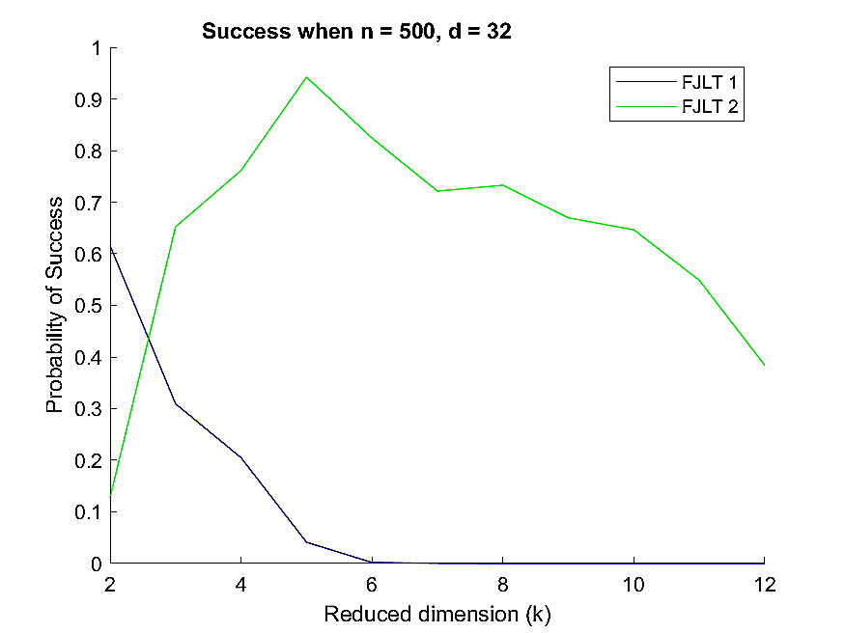
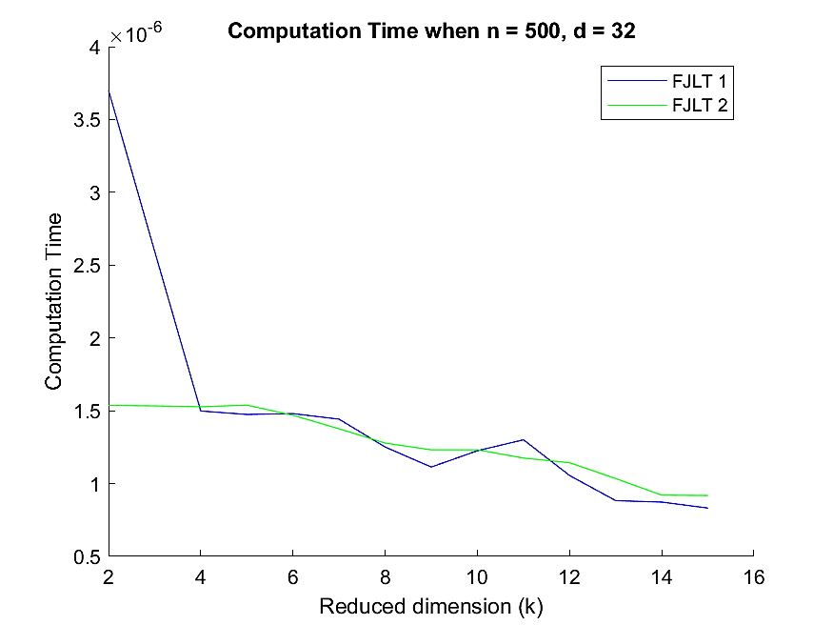
Comparison (1)
Dimension Reduction for Big Data
25th June 2018
k: reduced dimension; d: original dimension; n: sample size

Slide 30
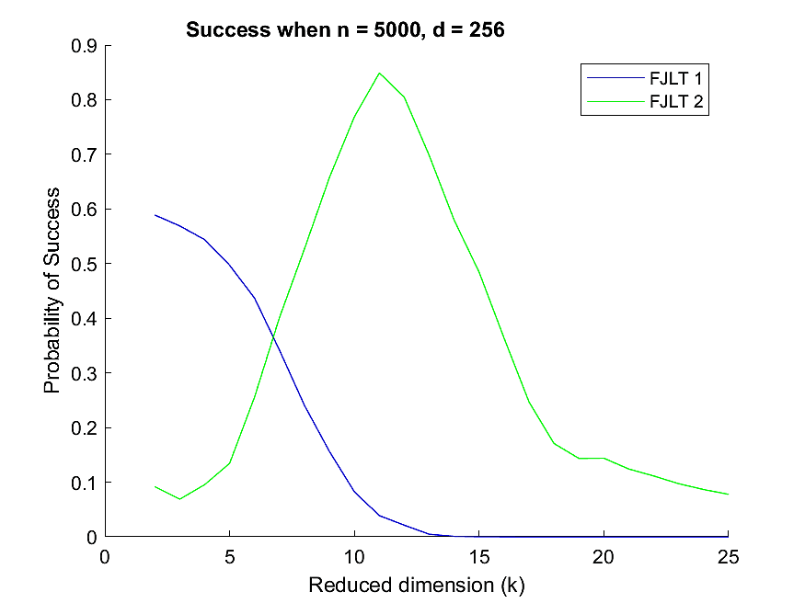
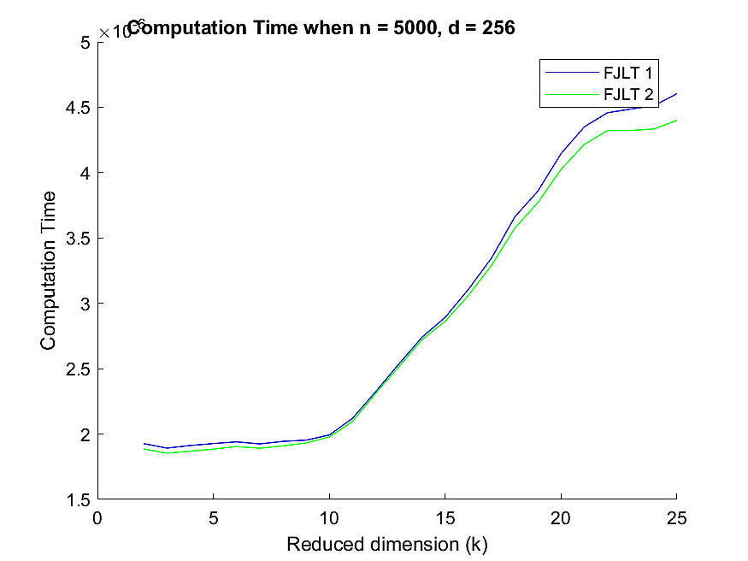
Comparison (2)
Dimension Reduction for Big Data
25th June 2018
k: reduced dimension; d: original dimension; n: sample size

Slide 31
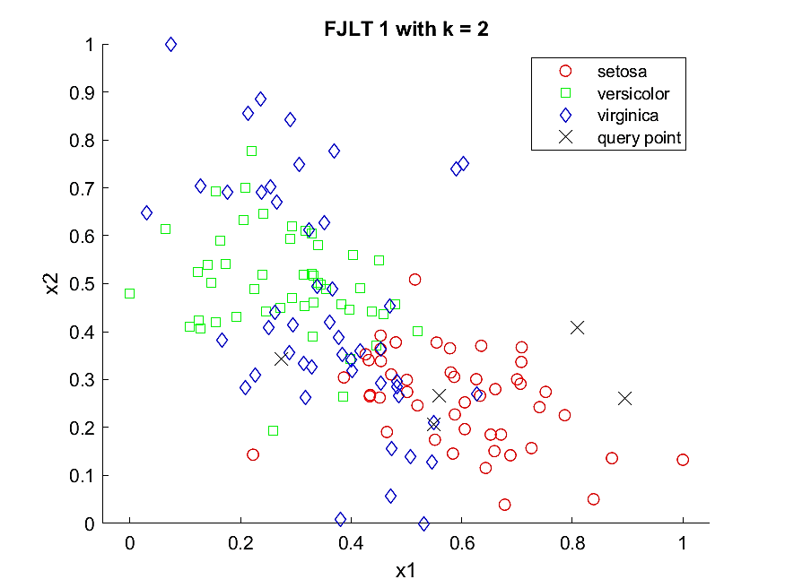
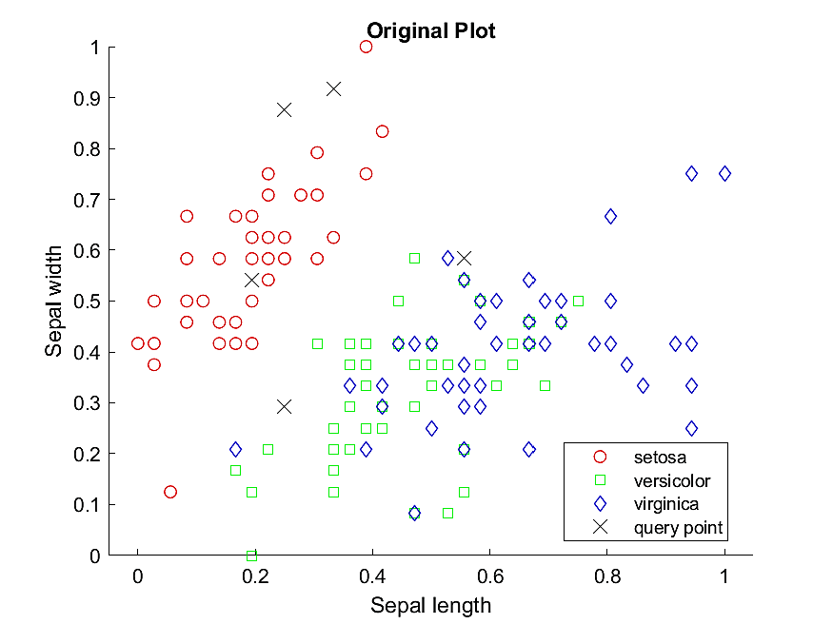
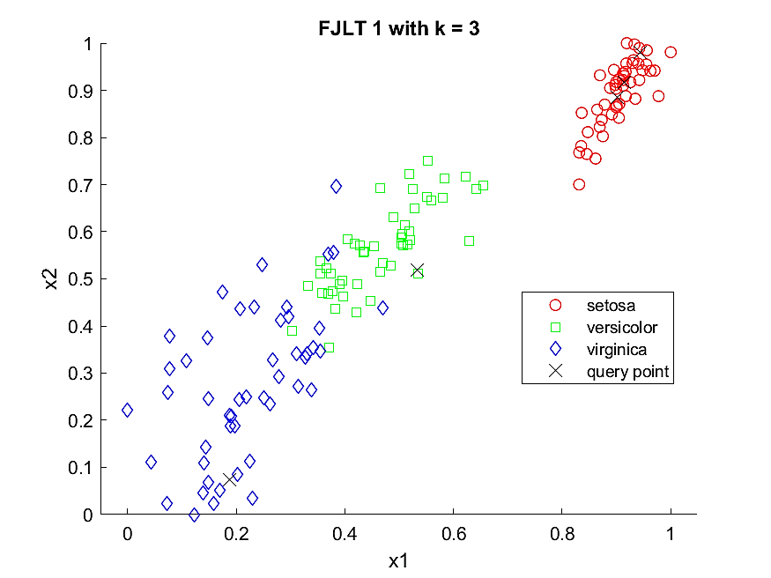
FJLT 1 on ML
Dimension Reduction for Big Data
25th June 2018
k: reduced dimension; d: original dimension;

Slide 32
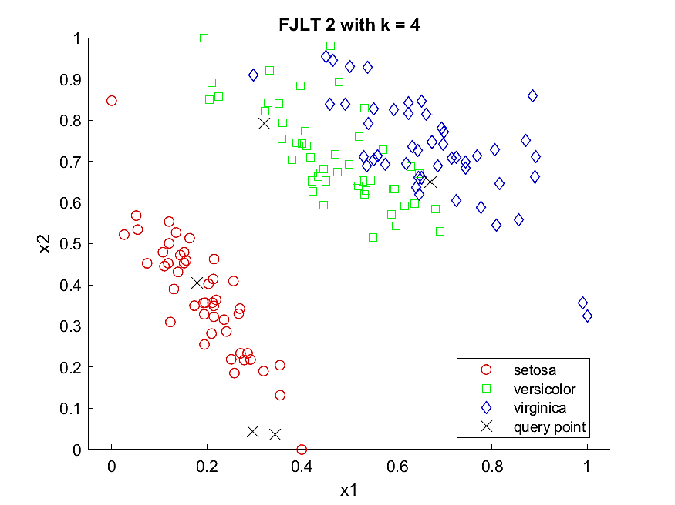
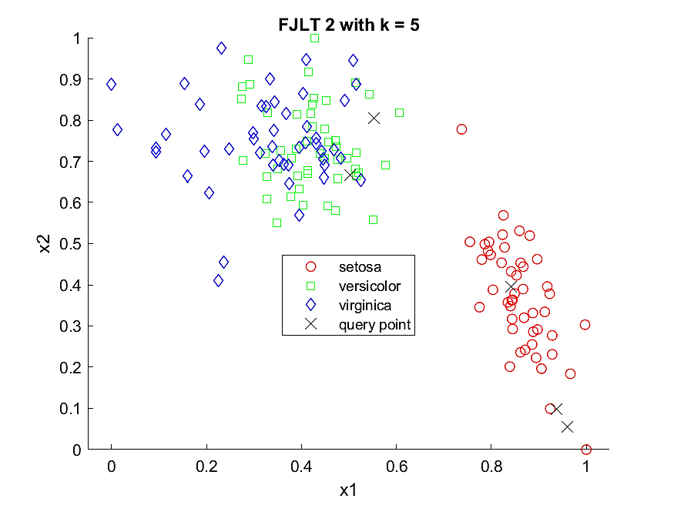
FJLT 2 on ML
Dimension Reduction for Big Data
25th June 2018
k: reduced dimension; d: original dimension;

Slide 33
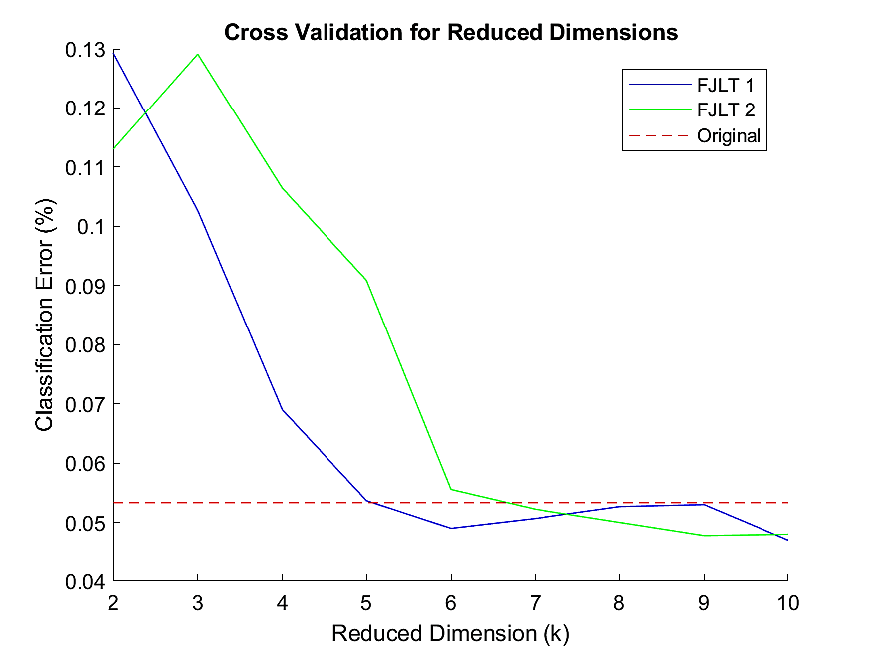
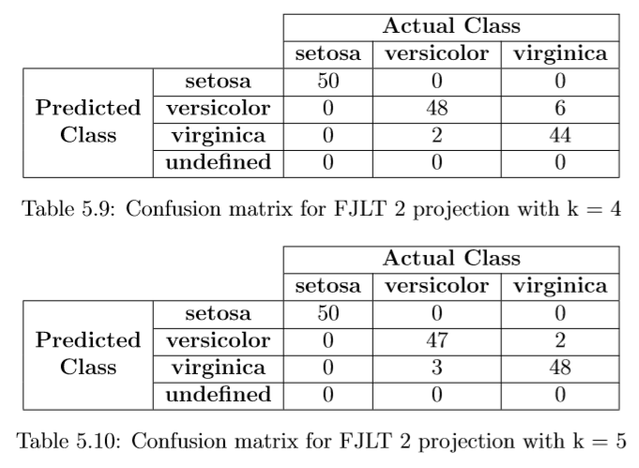
FJLT on ML
Dimension Reduction for Big Data
25th June 2018
Cross-validation test
k: reduced dimension; d: original dimension; n: sample size

Slide 34
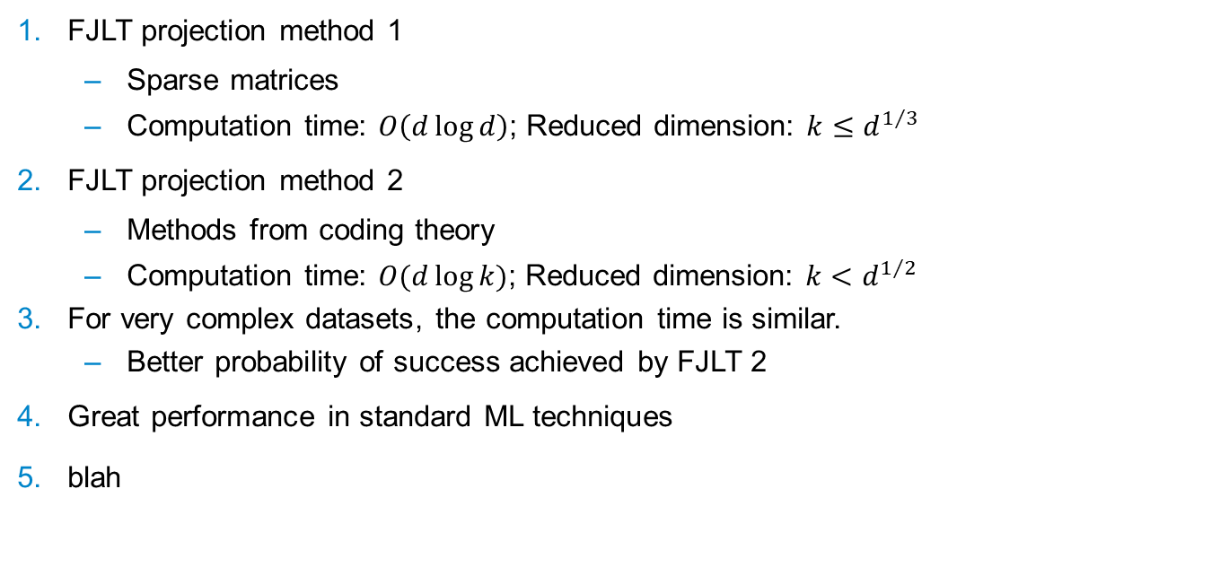
Conclusions
Dimension Reduction for Big Data
25th June 2018
FJLT projection method 1
Sparse matrices
Computation time: $O\left(d\log{d}\right)$; Reduced dimension: $k≤d^{1/3}$
FJLT projection method 2
Methods from coding theory
Computation time: $O(d\log{k})$; Reduced dimension: $k<d^{1/2}$
For very complex datasets, the computation time is similar.
Better probability of success achieved by FJLT 2
Great performance in standard ML techniques
blah
k: reduced dimension; d: original dimension; n: sample size
Notes:
yielding low-complexity solutions to dimension reduction
implement efficient random projectors for dimension reduction

Slide 35
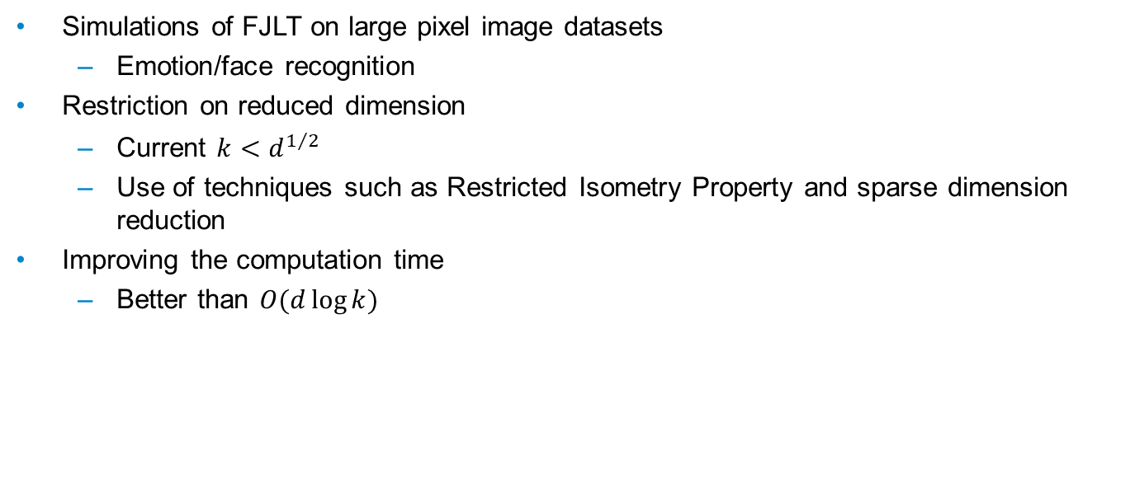
Future Work
Dimension Reduction for Big Data
25th June 2018
Simulations of FJLT on large pixel image datasets
Emotion/face recognition
Restriction on reduced dimension
Current $k<d^{1/2}$
Use of techniques such as Restricted Isometry Property and sparse dimension reduction
Improving the computation time
Better than $O(d\log{k})$
k: reduced dimension; d: original dimension; n: sample size

Slide 36
Thank you
25th June 2018
Devin Nanayakkara

Slide 37
APPENDIX
25th June 2018
Devin Nanayakkara

Slide 38
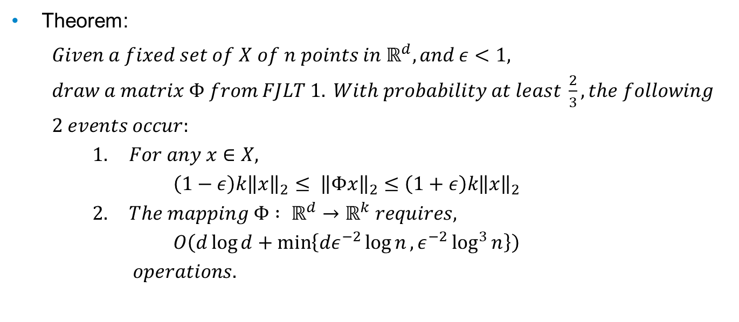
FJLT Method 1
Dimension Reduction for Big Data
25th June 2018
Theorem:
$Given a fixed set of X of n points in ℝ^{d}, and ε<1,$
$draw a matrix Φ from FJLT 1. With probability at least \frac{2}{3}, the following$
$2 events occur:$
$1. For any x∈X,$
$\left(1−ε\right)k{\left\|x\right\|}_{2}≤ {\left\|Φx\right\|}_{2}≤\left(1+ε\right)k{\left\|x\right\|}_{2}$
$2. The mapping Φ : ℝ^{d}→ℝ^{k} requires,$
$O\left(d\log{d+\min\left\{dε^{−2}\log{n},ε^{−2}\log^{3}{n}\right\}}\right)$
$operations.$
k: reduced dimension; d: original dimension; n: sample size

Slide 39
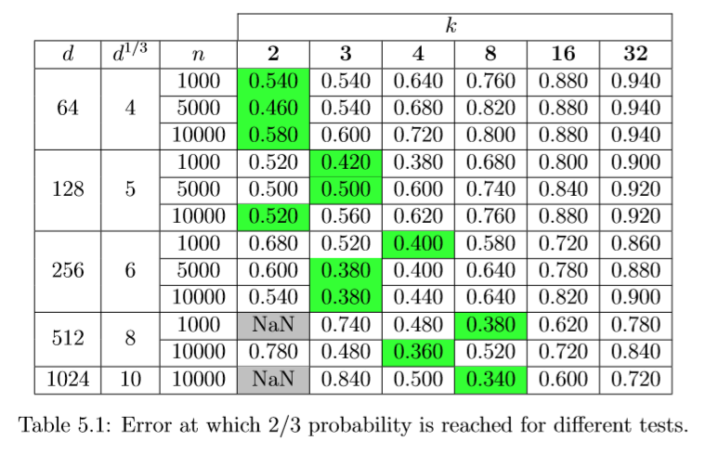
FJLT Method 1
Dimension Reduction for Big Data
25th June 2018
k: reduced dimension; d: original dimension; n: sample size

Slide 40
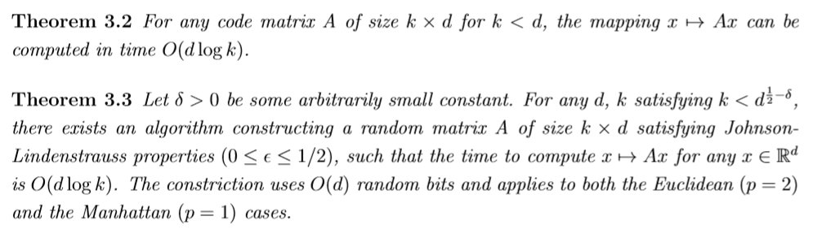
FJLT Method 2
Dimension Reduction for Big Data
25th June 2018
Theorems:
k: reduced dimension; d: original dimension; n: sample size

Slide 41

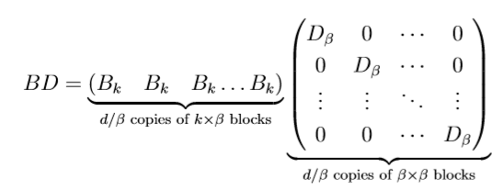

FJLT Method 2
Dimension Reduction for Big Data
25th June 2018
$$Α=B . D . Φ_{d}^{r}$$
k: reduced dimension; d: original dimension; n: sample size

Slide 42
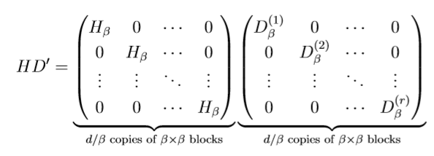
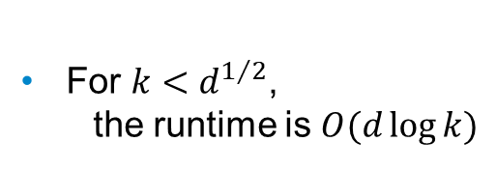

FJLT Method 2
Dimension Reduction for Big Data
25th June 2018
$$Α=B . D . Φ_{d}^{r}$$
For $k<d^{1/2}$,
the runtime is $O(d\log{k})$
k: reduced dimension; d: original dimension; n: sample size

Slide 43
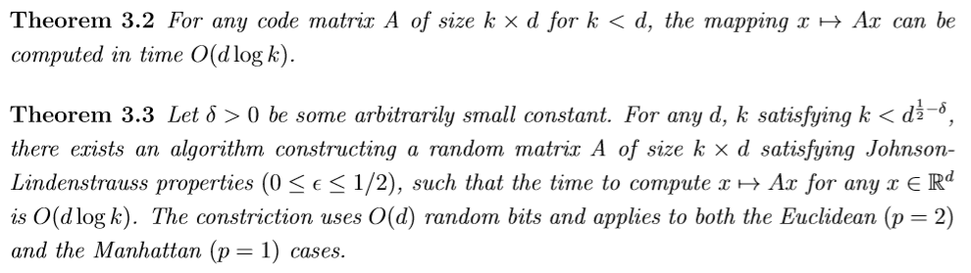
FJLT Method 2 (1)
Dimension Reduction for Big Data
25th June 2018
k: reduced dimension; d: original dimension; n: sample size

Slide 44



FJLT Method 2 (2)
Dimension Reduction for Big Data
25th June 2018
k: reduced dimension; d: original dimension; n: sample size

Slide 45

FJLT Method 2 (3)
Dimension Reduction for Big Data
25th June 2018
k: reduced dimension; d: original dimension; n: sample size

Slide 46

Comparison Tests
Dimension Reduction for Big Data
25th June 2018
k: reduced dimension; d: original dimension; n: sample size

Slide 47

FJLT on ML
Dimension Reduction for Big Data
25th June 2018
Summary of correctness tests
k: reduced dimension; d: original dimension; n: sample size

Slide 48

$l_{p}$-norm
Dimension Reduction for Big Data
25th June 2018

Slide 49

$$ℓ_{2} Regression$$
Appendix
25th June 2018
Least square fit of an overdetermined linear system
Old method:
Solution obtained by down sampling
Problem:
Complex solution
Down sampling distribution depends on norms of rows of the left singular vector matrix of the original system
Solution:
Multiply the equation matrix on the left by $HD$
The resulting left singular matrix have almost uniform sampling

Slide 50
Dimension Reduction for Big Data
25th June 2018

Slide 51
Dimension Reduction for Big Data
25th June 2018

